Slide 1




github 정리
https://github.com/pop9711/react
2023764060
최원호

Slide 2
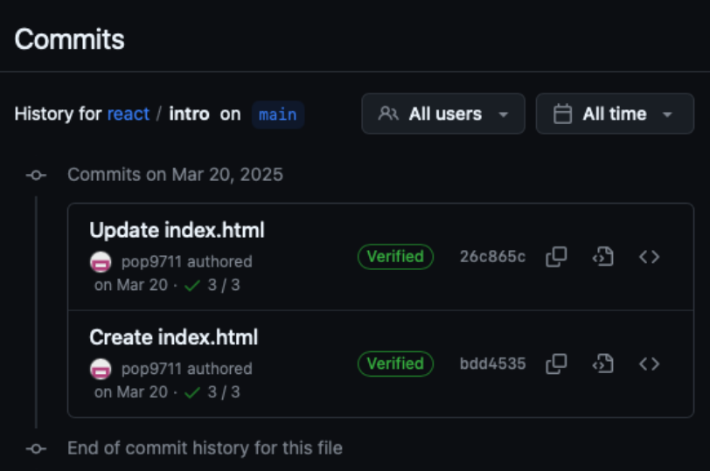
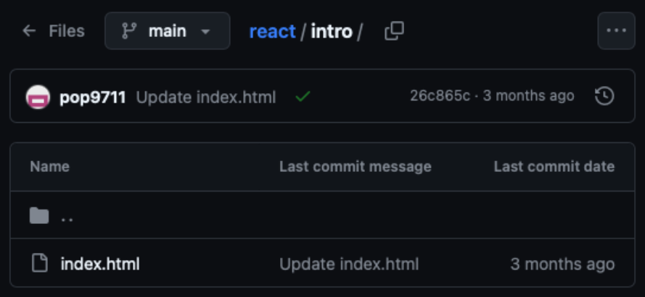

0306
https://github.com/pop9711/react/tree/main/intro

Slide 3
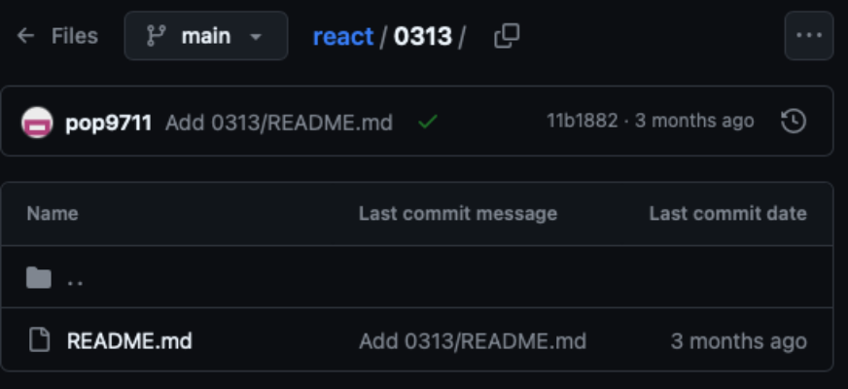
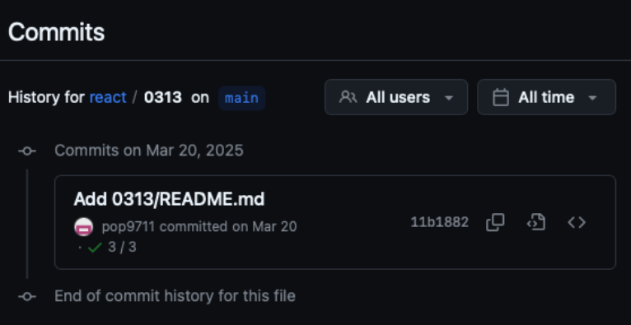
0313
https://github.com/pop9711/react/tree/main/0313

Slide 4
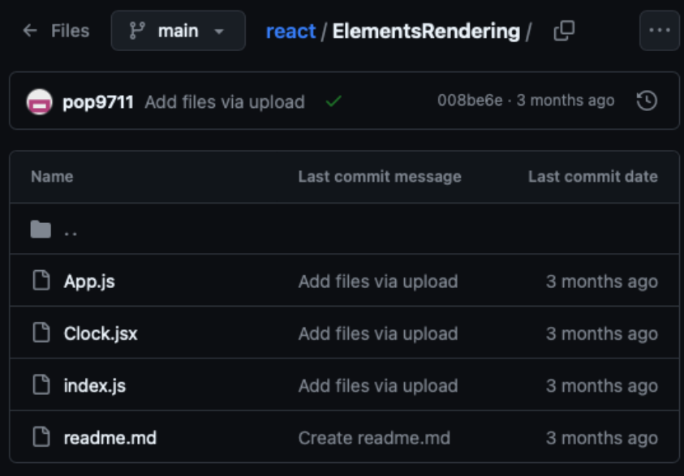
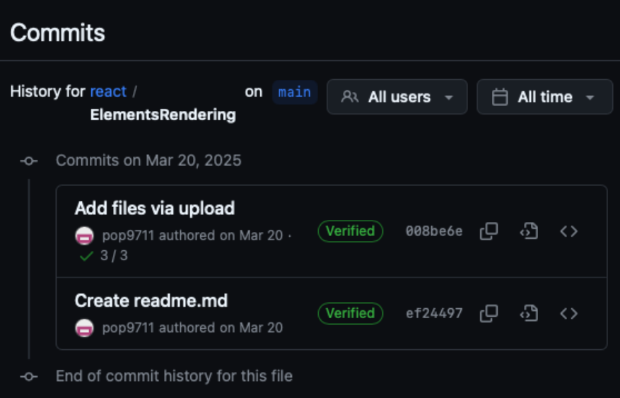
0320
https://github.com/pop9711/react/tree/main/ElementsRendering

Slide 5
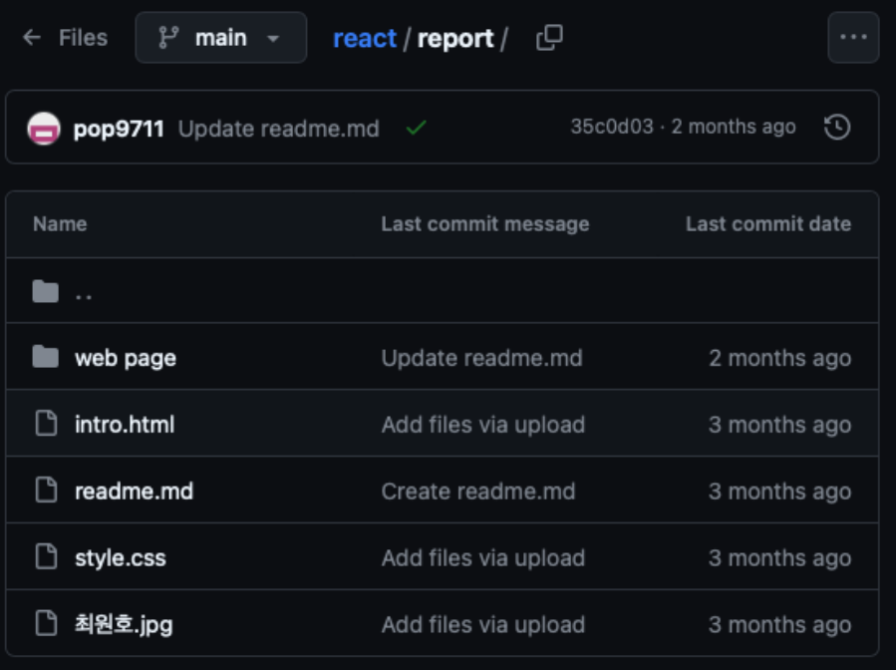
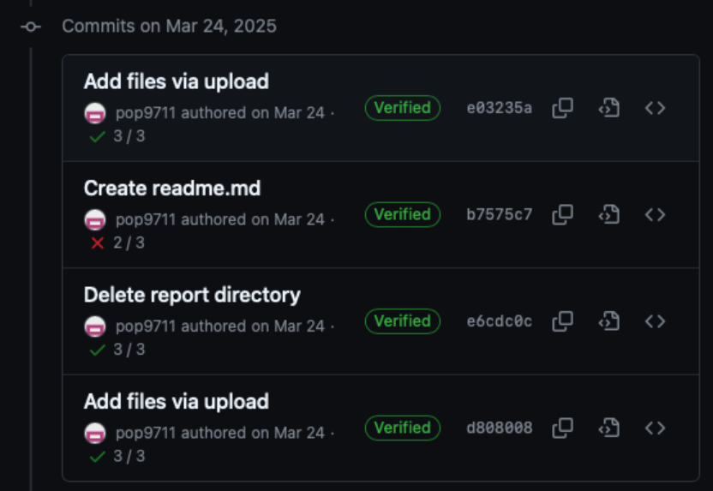
0320
https://github.com/pop9711/react/tree/main/report

Slide 6
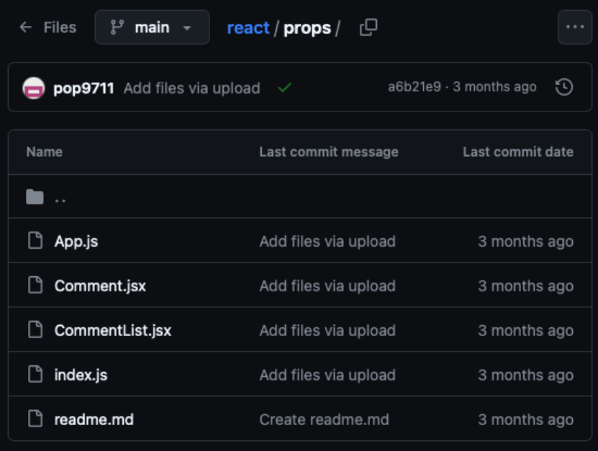
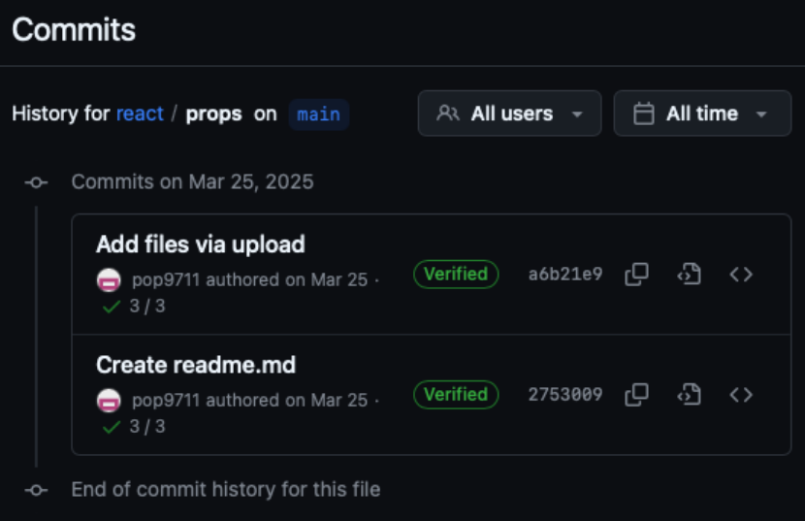
0327
https://github.com/pop9711/react/tree/main/props

Slide 7
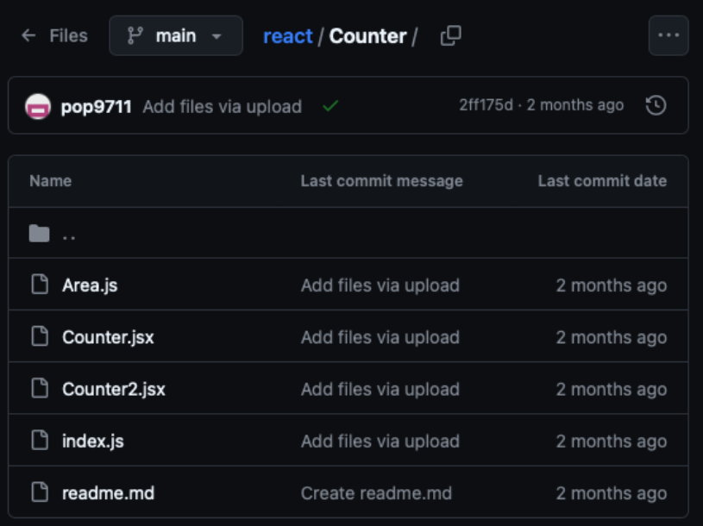
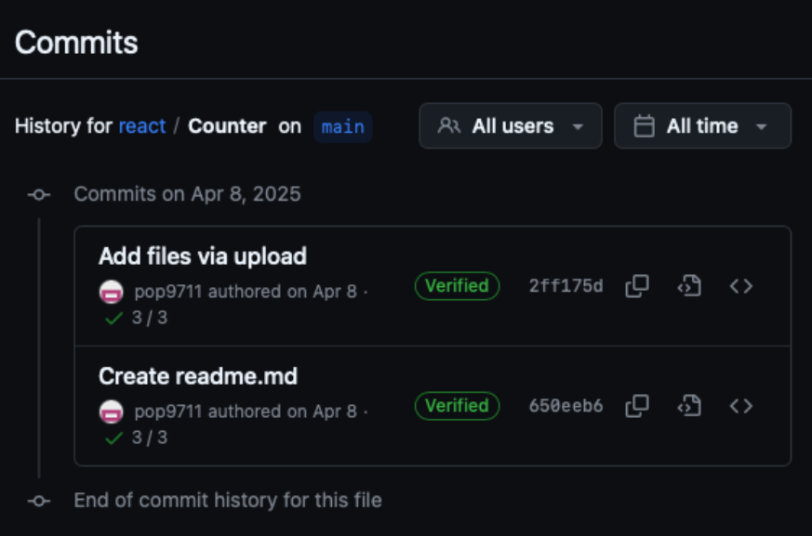
0403
https://github.com/pop9711/react/tree/main/Counter

Slide 8
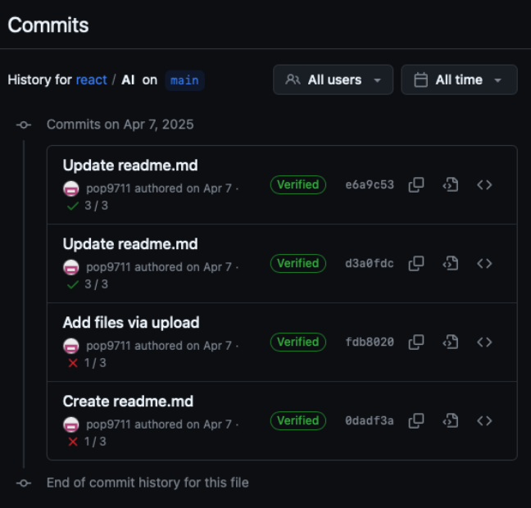
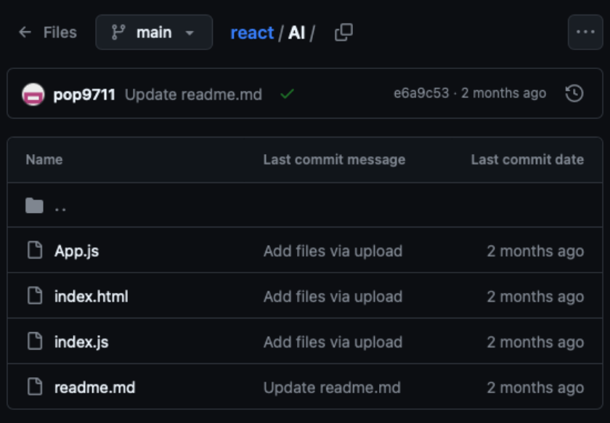
0403
https://github.com/pop9711/react/tree/main/AI

Slide 9
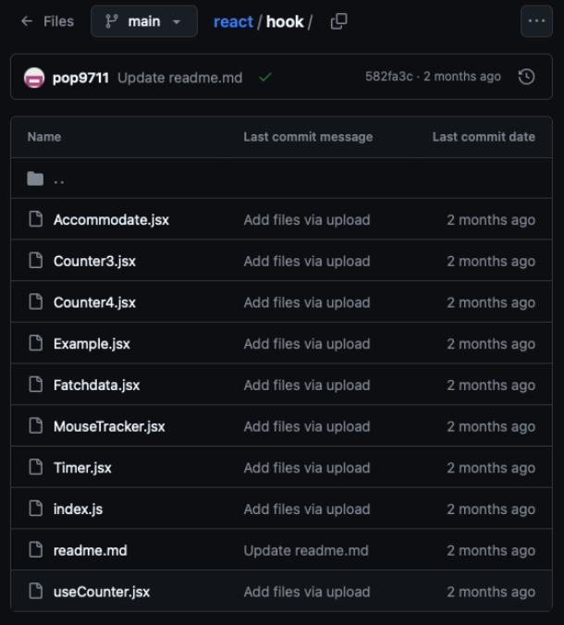
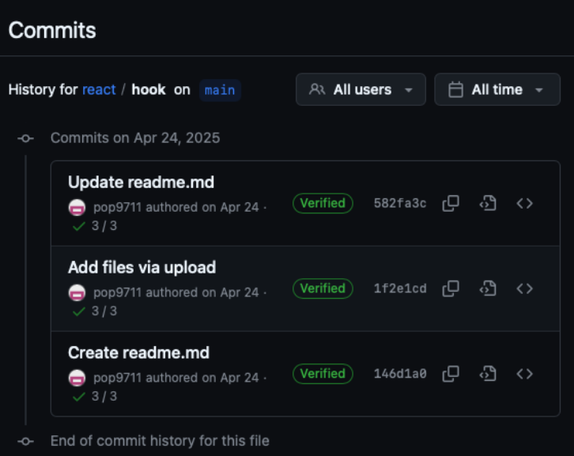
0417
https://github.com/pop9711/react/tree/main/hook

Slide 10
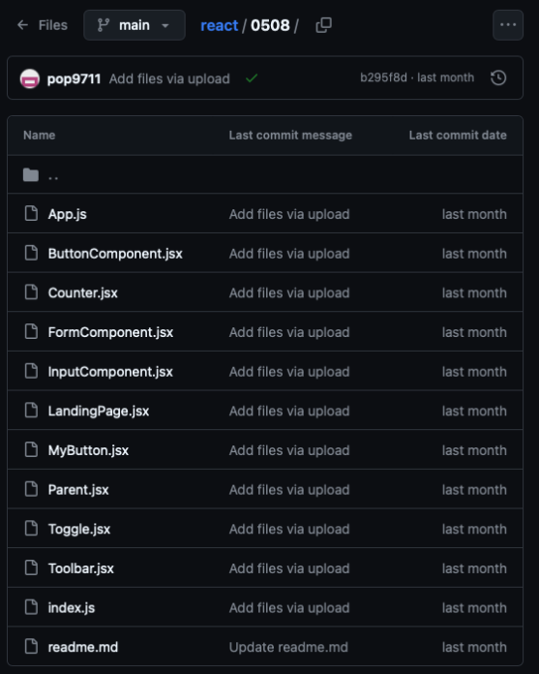
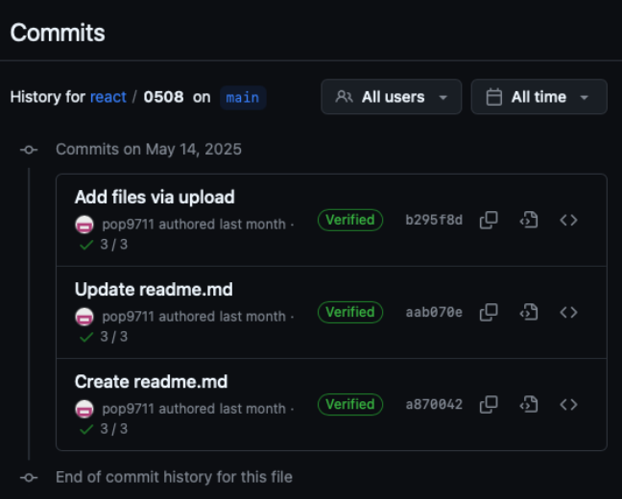
0508
https://github.com/pop9711/react/tree/main/0508

Slide 11
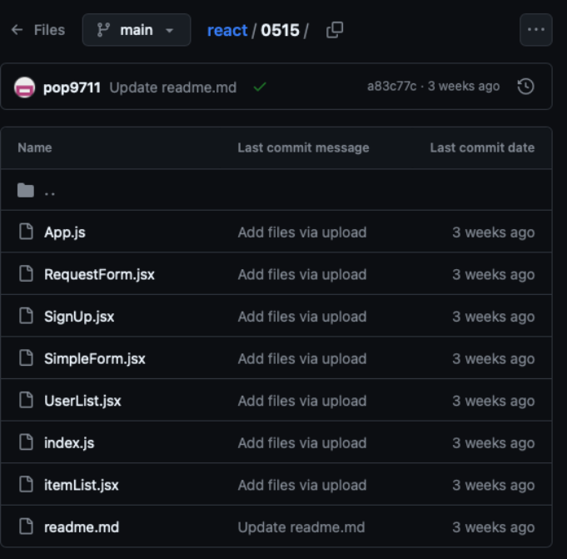
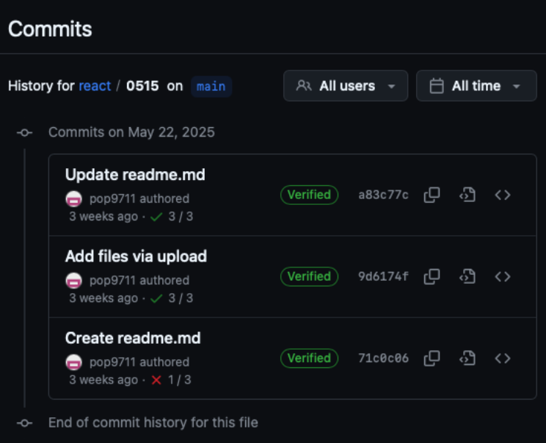
0515
https://github.com/pop9711/react/tree/main/0515

Slide 12
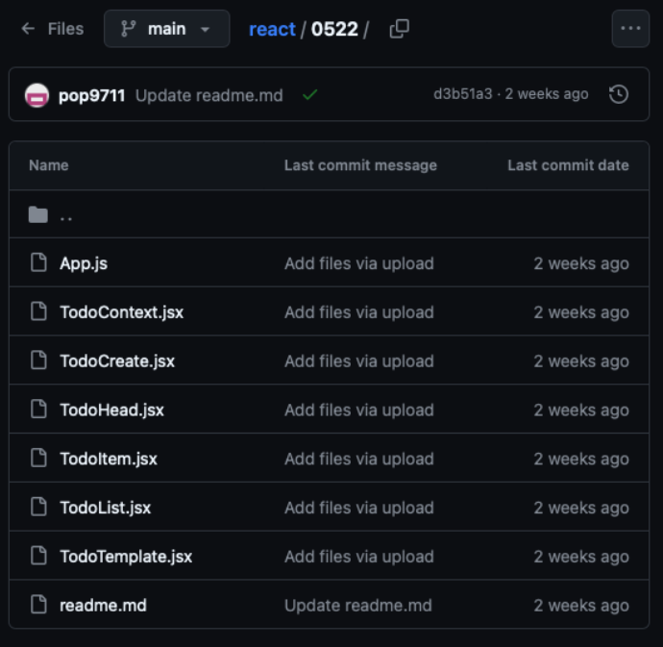
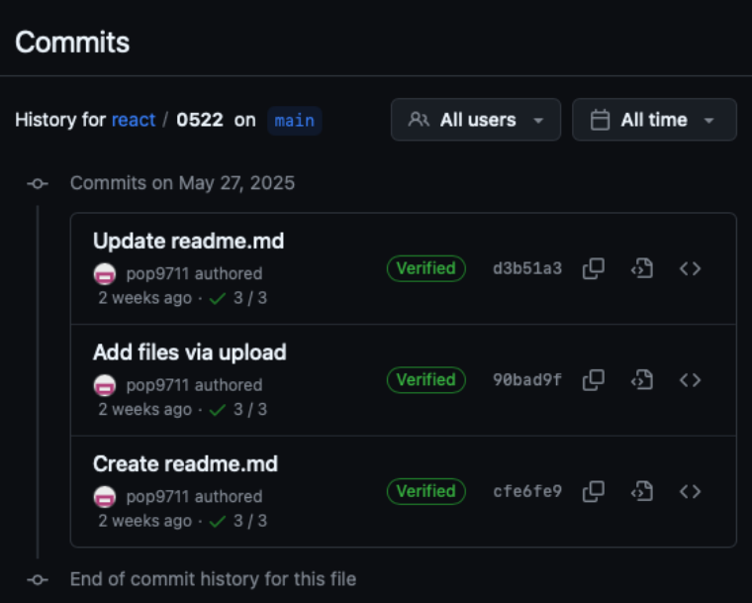
0522
https://github.com/pop9711/react/tree/main/0522

Slide 13
점수
15/15

